Slide 1


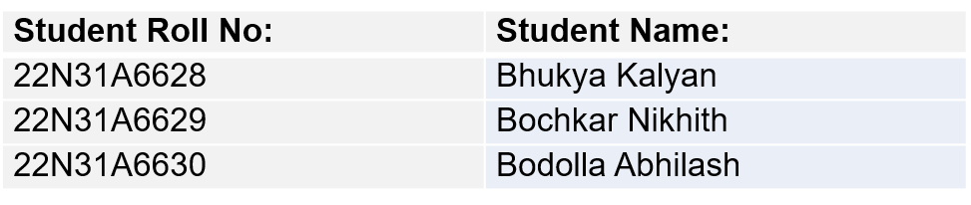
PROJECT ABSTRACT
PROJECT TITLE: urbanStep - Sneakers (A frontend E-commerce Website for Sneakers)
PROJECT GUIDE:
Mrs. P. Swapna
Assistant Professor
STUDENT BATCH DETAILS:
In the digital age, E-commerce platforms redefine shopping with convenience and choice. urbanStep - Sneakers targets sneaker enthusiasts, blending creativity and functionality for a seamless online experience. Using HTML, CSS, and JavaScript, it captures urban culture. Its UI design ensures easy navigation, while JavaScript adds dynamic features like real-time filtering. The responsive design ensures usability across devices. JavaScript further enriches the experience with interactive elements like product carousels and personalized recommendations, boosting engagement and satisfaction.
urbanStep - Sneakers signifies a shift in online sneaker shopping, setting a new standard with its innovative frontend and user-focused approach, redefining digital retail excellence and making the minimalistic interface a user friendly experience.

Slide 2

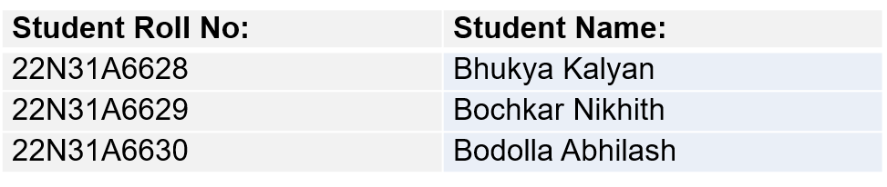
INTRODUCTION
PROJECT ABSTRACT
In the digital age, E-commerce platforms redefine shopping with convenience and choice. urbanStep - Sneakers targets sneaker enthusiasts, blending creativity and functionality for a seamless online experience. Using HTML, CSS, and JavaScript, it captures urban culture. Its UI design ensures easy navigation, while JavaScript adds dynamic features like real-time filtering. The responsive design ensures usability across devices. JavaScript further enriches the experience with interactive elements like product carousels and personalized recommendations, boosting engagement and satisfaction.
urbanStep - Sneakers signifies a shift in online sneaker shopping, setting a new standard with its innovative frontend and user-focused approach, redefining digital retail excellence and making the minimalistic interface a user friendly experience.
urbanStep - Sneakers is meticulously crafted using a blend of HTML, CSS, and JavaScript, offering a seamless and dynamic user experience. The foundation of the website is built upon HTML, providing the structure and backbone for content presentation. CSS is then employed to style every element, ensuring a visually stunning and cohesive design across all pages.
JavaScript is the magic behind the interactivity of UrbanStep-Sneakers, powering features like product filtering, image carousels, and dynamic content updates without page reloads.
By harnessing the power of these three core web technologies, UrbanStep-Sneakers delivers a modern and immersive e-commerce experience, enticing visitors to explore its diverse range of sneakers with ease and style.
STUDENT BATCH DETAILS:
PROJECT GUIDE:
Mrs. P. Swapna
Assistant Professor
PROJECT TITLE: urbanStep - Sneakers (A frontend E-commerce Website for Sneakers)

Slide 3



PROJECT ABSTRACT
USED TECHNOLOGIES
INTRODUCTION
urbanStep - Sneakers is meticulously crafted using a blend of HTML, CSS, and JavaScript, offering a seamless and dynamic user experience. The foundation of the website is built upon HTML, providing the structure and backbone for content presentation. CSS is then employed to style every element, ensuring a visually stunning and cohesive design across all pages.
JavaScript is the magic behind the interactivity of UrbanStep-Sneakers, powering features like product filtering, image carousels, and dynamic content updates without page reloads.
By harnessing the power of these three core web technologies, UrbanStep-Sneakers delivers a modern and immersive e-commerce experience, enticing visitors to explore its diverse range of sneakers with ease and style.
In the digital age, E-commerce platforms redefine shopping with convenience and choice. urbanStep - Sneakers targets sneaker enthusiasts, blending creativity and functionality for a seamless online experience. Using HTML, CSS, and JavaScript, it captures urban culture. Its UI design ensures easy navigation, while JavaScript adds dynamic features like real-time filtering. The responsive design ensures usability across devices. JavaScript further enriches the experience with interactive elements like product carousels and personalized recommendations, boosting engagement and satisfaction.
urbanStep - Sneakers signifies a shift in online sneaker shopping, setting a new standard with its innovative frontend and user-focused approach, redefining digital retail excellence and making the minimalistic interface a user friendly experience.

Slide 4
INTRODUCTION
USED TECHNOLOGIES
urbanStep - Sneakers is meticulously crafted using a blend of HTML, CSS, and JavaScript, offering a seamless and dynamic user experience. The foundation of the website is built upon HTML, providing the structure and backbone for content presentation. CSS is then employed to style every element, ensuring a visually stunning and cohesive design across all pages.
JavaScript is the magic behind the interactivity of UrbanStep-Sneakers, powering features like product filtering, image carousels, and dynamic content updates without page reloads.
By harnessing the power of these three core web technologies, UrbanStep-Sneakers delivers a modern and immersive e-commerce experience, enticing visitors to explore its diverse range of sneakers with ease and style.

Slide 5

EXISTING SYSTEM
USED TECHNOLOGIES
HTML provides the structural framework for urbanStep-Sneakers, organizing content such as product listings and navigation menus.
While JavaScript adds dynamic functionality, enabling features like real-time product filtering and interactive elements for an engaging user experience.
CSS enhances the visual presentation, ensuring a sleek and cohesive design.
Visual Studio Code

Slide 6
EXISTING SYSTEM
USED TECHNOLOGIES
Visual Studio Code is crucial for developing the website in our project, providing a powerful and lightweight integrated development environment (IDE). With its user-friendly interface, Visual Studio Code enhances efficiency, ensuring a smooth and productive development process for our e-commerce platform.
HTML provides the structural framework for urbanStep-Sneakers, organizing content such as product listings and navigation menus.
CSS enhances the visual presentation, ensuring a sleek and cohesive design.
Visual Studio Code
In the current E-commerce landscape dominated by giants like Amazon and Flipkart, businesses benefit from global reach and convenience. However, the vastness of these platforms doesn't guarantee reaching every potential customer, leading to increased competition.
To overcome this limitation, businesses are exploring independent online storefronts and direct-to-consumer channels. While major
E-commerce platforms offer significant growth opportunities, it's essential for businesses to diversify strategies to ensure a personalized reach in today's dynamic and competitive marketplace.
While JavaScript adds dynamic functionality, enabling features like real-time product filtering and interactive elements for an engaging user experience.

Slide 7
PROPOSED SYSTEM
USED TECHNOLOGIES
EXISTING SYSTEM
In the current E-commerce landscape dominated by giants like Amazon and Flipkart, businesses benefit from global reach and convenience. However, the vastness of these platforms doesn't guarantee reaching every potential customer, leading to increased competition.
To overcome this limitation, businesses are exploring independent online storefronts and direct-to-consumer channels. While major
E-commerce platforms offer significant growth opportunities, it's essential for businesses to diversify strategies to ensure a personalized reach in today's dynamic and competitive marketplace.
Visual Studio Code is crucial for developing the website in our project, providing a powerful and lightweight integrated development environment (IDE). With its user-friendly interface, Visual Studio Code enhances efficiency, ensuring a smooth and productive development process for our e-commerce platform.
Visual Studio Code
Our e-commerce solution targets smaller retailers, offering a cost-effective pathway to online sales. Through our intuitive frontend platform, retailers effortlessly link their store details to Shopify, enabling seamless online transactions. This approach provides an affordable and accessible entry into e-commerce, empowering smaller businesses to expand their reach and enhance sales.
By bridging the gap between retailers and the vast online marketplace, our proposed system ensures affordability and increased visibility, fostering growth for businesses of all sizes.

Slide 8
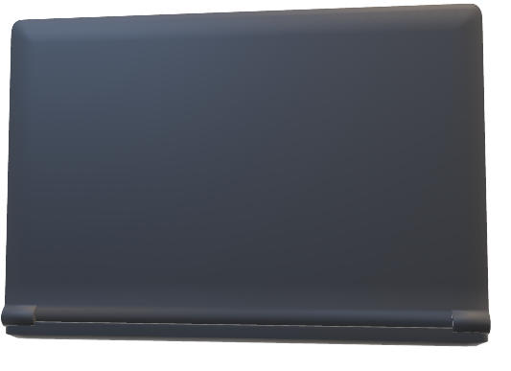
EXISTING SYSTEM
SOFTWARE REQUIREMENTS
PROPOSED SYSTEM
Our e-commerce solution targets smaller retailers, offering a cost-effective pathway to online sales. Through our intuitive frontend platform, retailers effortlessly link their store details to Shopify, enabling seamless online transactions. This approach provides an affordable and accessible entry into e-commerce, empowering smaller businesses to expand their reach and enhance sales.
By bridging the gap between retailers and the vast online marketplace, our proposed system ensures affordability and increased visibility, fostering growth for businesses of all sizes.
In the current E-commerce landscape dominated by giants like Amazon and Flipkart, businesses benefit from global reach and convenience. However, the vastness of these platforms doesn't guarantee reaching every potential customer, leading to increased competition.
To overcome this limitation, businesses are exploring independent online storefronts and direct-to-consumer channels. While major
E-commerce platforms offer significant growth opportunities, it's essential for businesses to diversify strategies to ensure a personalized reach in today's dynamic and competitive marketplace.
Web Browser:
An up-to-date web browser based on web 2.0 or above
FTP client:
To upload files to your web
Internet connection:
A stable internet connection for better experience
Operating system:
Windows 8 or later, or any 64 bit
operating system

Slide 9
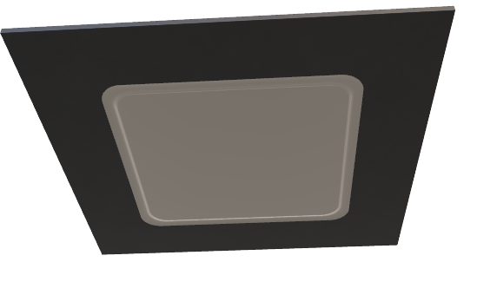
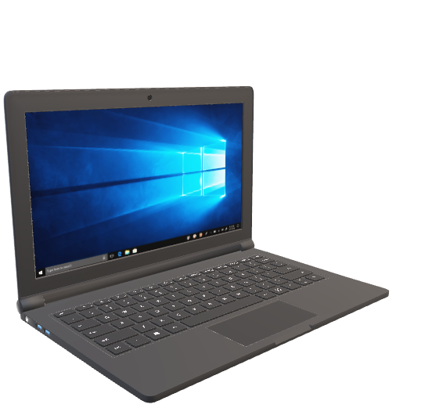
PROPOSED SYSTEM
HARDWARE REQUIREMENTS
SOFTWARE REQUIREMENTS
Web Browser:
An up-to-date web browser based on web 2.0 or above
FTP client:
To upload files to your web
Internet connection:
A stable internet connection for better experience
Operating system:
Windows 8 or later, or any 64 bit
operating system
Device:
A laptop, PC, smartphone, or tablet
Processor:
Intel Pentium 4 or later, any 2 Ghz
processor or later
Hard drive:
A minimum of 8 to 16 GB free space
Memory:
A minimum of 2 to 4 GB of RAM
Our e-commerce solution targets smaller retailers, offering a cost-effective pathway to online sales. Through our intuitive frontend platform, retailers effortlessly link their store details to Shopify, enabling seamless online transactions. This approach provides an affordable and accessible entry into e-commerce, empowering smaller businesses to expand their reach and enhance sales.
By bridging the gap between retailers and the vast online marketplace, our proposed system ensures affordability and increased visibility, fostering growth for businesses of all sizes.

Slide 10
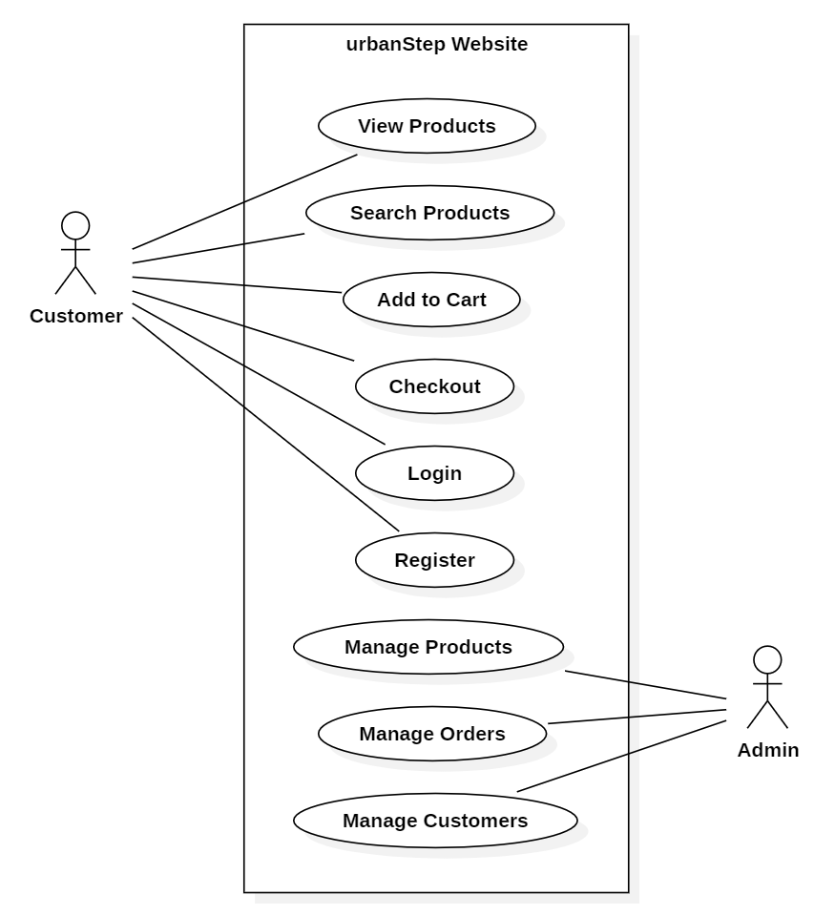
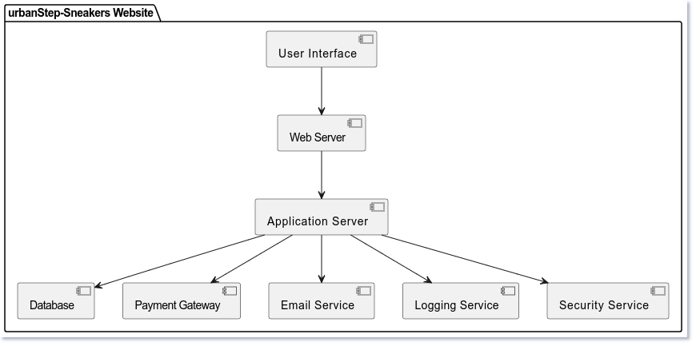
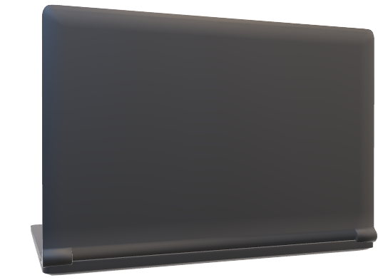
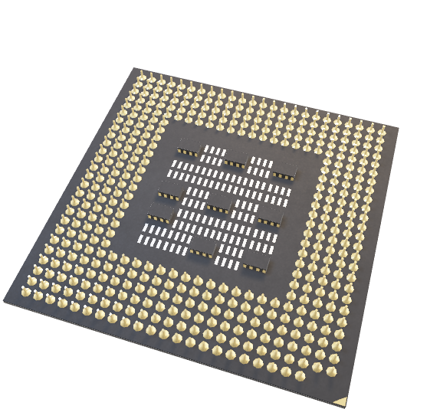
SOFTWARE REQUIREMENTS
CONCLUSION
SYSTEM ARCHITECTURE
UML DIAGRAMS
HARDWARE REQUIREMENTS
Device:
A laptop, PC, smartphone, or tablet
Processor:
Intel Pentium 4 or later, any 2 Ghz
processor or later
Hard drive:
A minimum of 8 to 16 GB free space
Memory:
A minimum of 2 to 4 GB of RAM
USE CASE DIAGRAM
In conclusion, our sneakers' web development journey has been a triumph of innovation and collaboration. The website is more than a platform; it's a testament to our brand identity and commitment to excellence. Through sleek design and cutting-edge technology, we've crafted an immersive and seamless user experience. This launch is not an end but a beginning, as we stride confidently into the digital future.
I extend my gratitude to the dedicated team for their hard work. Here's to the exciting journey ahead, where our sneakers find their digital home and our brand continues to flourish. Thank you all!
Web Browser:
An up-to-date web browser based on web 2.0 or above
FTP client:
To upload files to your web
Internet connection:
A stable internet connection for better experience
Operating system:
Windows 8 or later, or any 64 bit
operating system

Slide 11
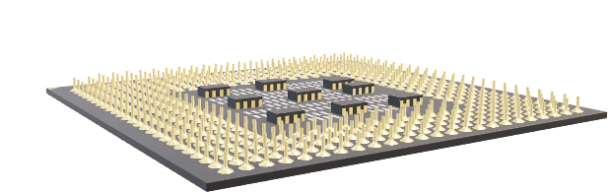
UML DIAGRAMS
HARDWARE REQUIREMENTS
SYSTEM ARCHITECTURE
3. CLASS DIAGRAM
Device:
A laptop, PC, smartphone, or tablet
Processor:
Intel Pentium 4 or later, any 2 Ghz
processor or later
Hard drive:
A minimum of 8 to 16 GB free space
Memory:
A minimum of 2 to 4 GB of RAM

Slide 12

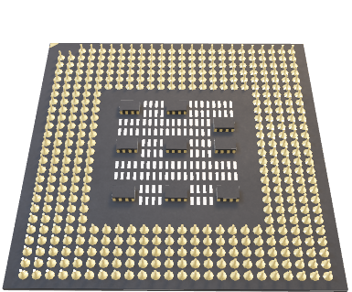
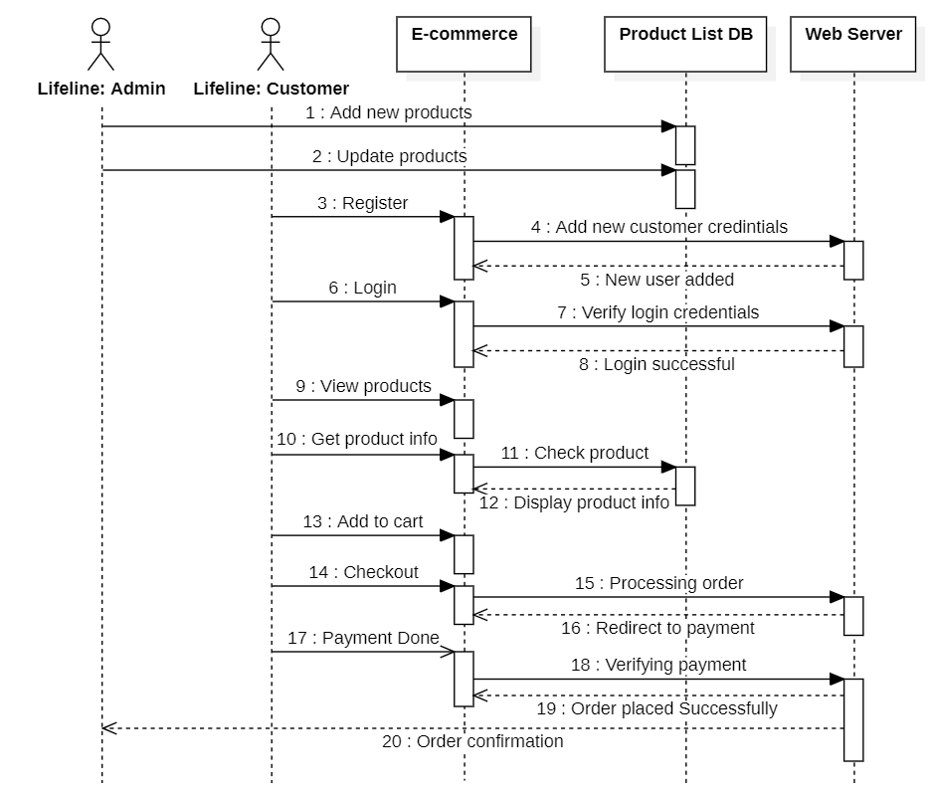
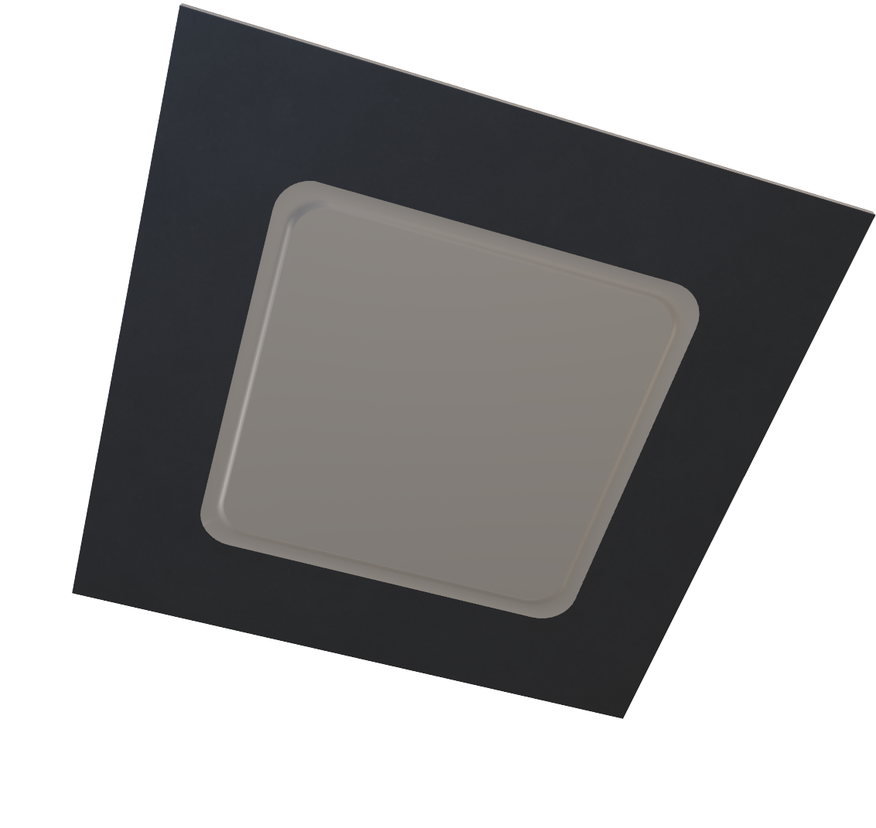
SYSTEM ARCHITECTURE
HARDWARE REQUIREMENTS
UML DIAGRAMS
USE CASE DIAGRAM
2. SEQUENCE DIAGRAM
Computer:
A laptop, PC, smartphone, or tablet
Processor:
Intel Pentium 4 or later, any 2 Ghz
processor or later
Hard drive:
A minimum of 8 to 16 GB free space
Memory:
A minimum of 2 to 4 GB of RAM

Slide 13
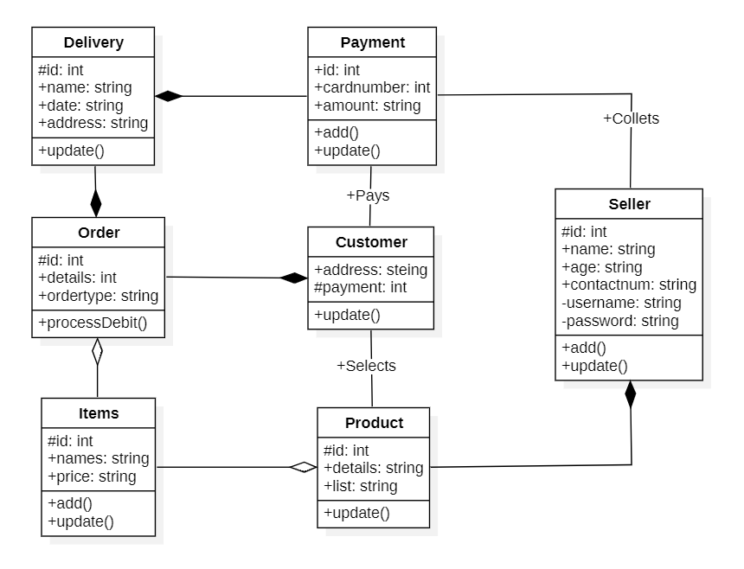
UML DIAGRAMS
3. CLASS DIAGRAM
2. SEQUENCE DIAGRAM
USE CASE DIAGRAM

Slide 14
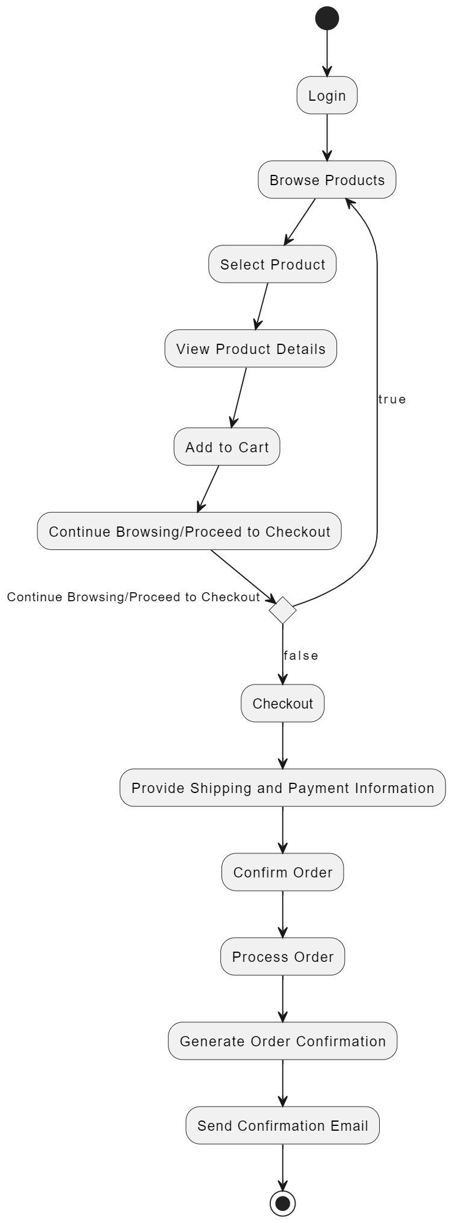
UML DIAGRAMS
3. CLASS DIAGRAM
4. ACTIVITY DIAGRAM
2. SEQUENCE DIAGRAM

Slide 15
CONCLUSION
UML DIAGRAMS
3. CLASS DIAGRAM
4. ACTIVITY DIAGRAM
In conclusion, our sneakers' web development journey has been a triumph of innovation and collaboration. The website is more than a platform; it's a testament to our brand identity and commitment to excellence. Through sleek design and cutting-edge technology, we've crafted an immersive and seamless user experience. This launch is not an end but a beginning, as we stride confidently into the digital future.

Slide 16
UML DIAGRAMS
HARDWARE REQUIREMENTS
CONCLUSION
In conclusion, our sneakers' web development journey has been a triumph of innovation and collaboration. The website is more than a platform; it's a testament to our brand identity and commitment to excellence. Through sleek design and cutting-edge technology, we've crafted an immersive and seamless user experience. This launch is not an end but a beginning, as we stride confidently into the digital future.
4. ACTIVITY DIAGRAM

Slide 17
Computer:
A laptop, PC, smartphone, or tablet
Processor:
Intel Pentium 4 or later, any 2 Ghz
processor or later
Hard drive:
A minimum of 8 to 16 GB free space
Memory:
A minimum of 2 to 4 GB of RAM
In conclusion, our sneakers' web development journey has been a triumph of innovation and collaboration. The website is more than a platform; it's a testament to our brand identity and commitment to excellence. Through sleek design and cutting-edge technology, we've crafted an immersive and seamless user experience. This launch is not an end but a beginning, as we stride confidently into the digital future.
I extend my gratitude to the dedicated team for their hard work. Here's to the exciting journey ahead, where our sneakers find their digital home and our brand continues to flourish. Thank you all!
CONCLUSION

